Slide 1
Python Server-side Programming
Objects and Classes in Python

Slide 2
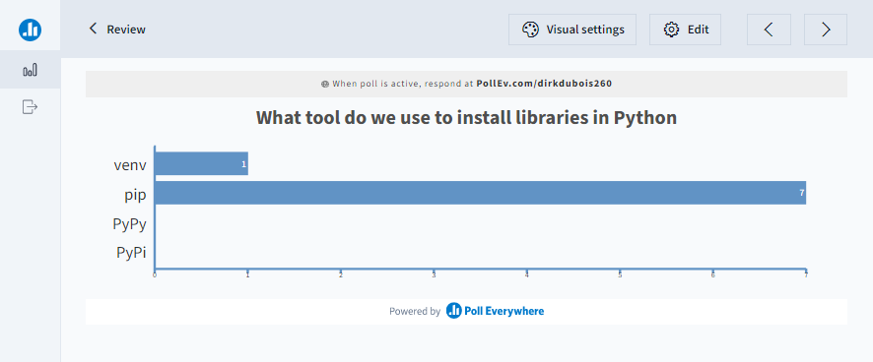
Let’s review

Slide 3
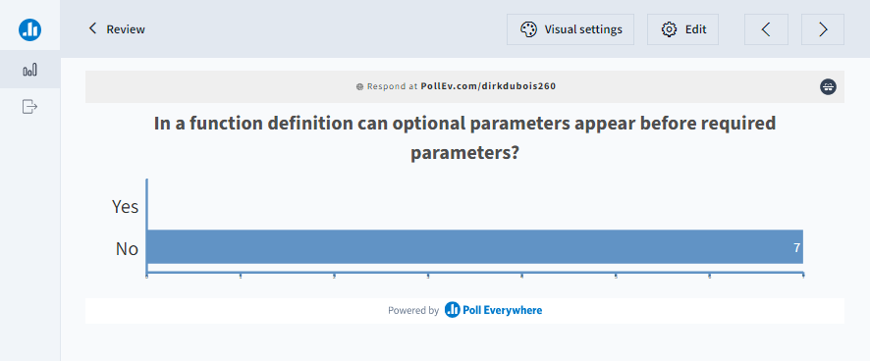
Let’s review

Slide 4
Python uses different words to describe class structures
Java
Static members
Members
Python
Attributes
Instance variables
Instance functions
Instance methods

Slide 5
Recall objects are instantiated from classes
Class
Object
class Student:
def __init__(self, first, last):
self.first = first
self.last = last
def __repr__(self):
return f"{self.first} {self.last}"
if __name__ == "__main__":
bob = Student("Bob", "Smith")
jim = Student("Jim", "Smith")
print(bob)

Slide 6
class keyword defines a class
Can contain simple attributes
Can contain methods
Can contain special methods, such as __init__(), __repr__()
class Dogs:
dog_types = ["small", "medium", "large"]
kinds_of_dogs = 3
def get_dog_type(name):
if name == "Bulldog":
return Dogs.dog_types[2]

Slide 7
Classes are very flexible
class Bag: # Class definition
max = 5 # Class variable (attribute)
def __init__(self): # Initalizer
self.data = [] # Instance variable
def add(self, x): # Instance method
self.data.append(x)
def change_max(x): # Non-instance method
Bag.max = x

Slide 8
__init__() is a special function called during construction
__init__() initializes the object
Can be used to pass arguments during construction
Is used to set instance variables
First parameter always represents the current instance of the object
We use self as the convention
class Address:
def __init__(self):
self.street = ""
self.city = ""
self.state = ""
…
home = Address()
home.street = "123 Maple"
home.city = "New York"
home.state = "NY"

Slide 9
Instance functions must also take self as the first parameter
Any method that manipulates the instance requires self as the first parameter
Methods without self are equivalent to static methods in Java
When invoking, we don’t provide self as callers
class Address:
def __init__(self):
self.street = ""
self.city = ""
self.state = ""
def print_street(self):
print(f'Lives on \
{self.street} street’)
…
home = Address()
home.street = "123 Maple"
home.print_street()

Slide 10
Instance variables should not be confused with attributes
Class attributes persist across instances
Instance variables are unique to that instance
We can have incorrect behaviour even though we referenced the attribute with self
class Dog:
tricks = []
def __init__(self, name):
self.name = name
def add_trink(self, trick):
self.tricks.append(trick)
…
a = Dog('Fido')
b = Dog('Bud')
a.add_trink('roll over')
b.add_trink('play dead')
print(a.tricks)
# ['roll over', 'play dead']

Slide 11
Defining Classes and using Objects
Create a file called post.py
Add a class called Post that has a title, id, author, text, and tag line
Create a file called comment.py
Add a class called Comment that has an author, text

Slide 12
public/private is not really a concept in Python
A naming convention is used to indicate public, protected, private
public members have no leading underscores (_)
protected members have one leading underscores
Private members have two leading underscores
class Protections:
def __init__(self):
self.__private = "Private"
self._protected = "Protected"
self.public = "Public“
…
a = Protections()
print(a.public) # Public
print(a._protected) # Protected
print(a.__private) # Error

Slide 13
Name mangling is performed when using two underscores
Instance variables with two leading underscores (__) is textually replaced.
E.g., __spam is replaced with _classname__spam
Is useful when we have subclasses and want to override methods
class Protections:
def __init__(self):
self.__private = "Private"
self._protected = "Protected"
self.public = "Public“
…
a = Protections()
print(a._Protections__private) # Private
print(a.__private) # Error

Slide 14
__new__() is the actual constructor
All classes have special methods that can be overridden
__new__() is the actual constructor of the object
Rarely overridden
__repr__() gets called by repr() internally
__str__() gets called by print and format for the pretty string
class Overrides:
def __init__(self, name, info):
self.name = name
self.info = info
def __repr__(self):
return f"Overrides({self.name}, {self.info})"
def __str__(self):
return f'{self.name} {self.info}’
…
a = Overrides('a', 'b')
print(a) # a b
b = repr(a)
print(b) # Overrides(a, b)

Slide 15
Python uses iter and next to loop over collections
iter gives us the iteration object
next loops over the collection
StopIteration exception is raised when we should stop looping
s = 'abc'
for c in s:
print(c)
it = iter(s)
print(next(it)) # a
print(next(it)) # b
print(next(it)) # c
print(next(it)) # Raises StopIteration

Slide 16
We can use generators to support iterating over our object
class Reverse:
def __init__(self, data):
self.data = data
self.index = len(data)
def __iter__(self):
return self
def __next__(self):
if self.index == 0:
raise StopIteration
self.index = self.index - 1
return self.data[self.index]
rev = Reverse('abc')
for c in rev:
print(c) # c, b, a

Slide 17
Inheritance and Polymorphism
Creating derived classes

Slide 18
Objects can be derived from a base class
class Person:
def __init__(self, name, age):
self._name = name
self.age = age
def show(self):
print(f'{self._name}: {self.age}')
class Student(Person):
def __init__(self, name, age, sem):
super().__init__(name, age)
self.sem = sem
def show(self):
super().show()
print(f'Semester:{self.sem}')
if __name__ == "__main__":
bob = Person("Bob", 20)
jim = Student("Jim", 18, 1)
bob.show() # Bob: 20
jim.show() # Jim: 18 \n Semester:1

Slide 19
Polymorphism allows different sub classes to override methods
class Figure:
def __init__(self, name, color):
self.name = name
self._color = color
def area(self):
pass
def display(self):
print(f"Name: {self.name}, Color: {self._color}")
class Circle(Figure):
def __init__(self, name, color, x, y, radius):
super().__init__(name, color)
self.__x = x
self.__y = y
self.__radius = radius
def area(self):
return 3.14 * (self.__radius**2)
def display(self):
super().display()
print(f"radius: {self.__radius}")

Slide 20
Let’s code together
In post.py create a new class ImagePost that derives from Post
Add instances variable called images, path
Implement iter and next to loop through all file paths in images

Slide 21
Setting up Linux
Connect to your DC385 Linux machine over SSH
Clone your demo repo
Deploy your server
Connect from another machine

Slide 22
